Slide 1

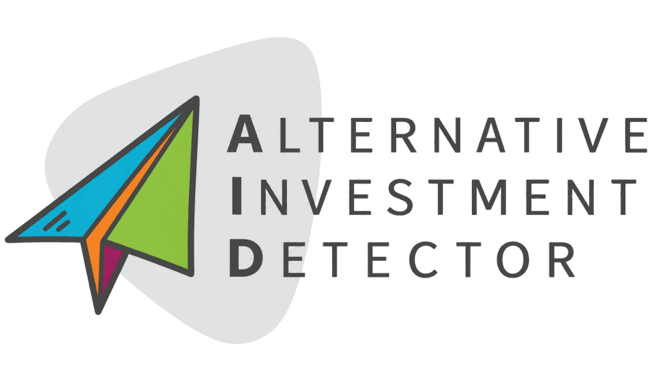

May the best idea win: Rethinking how regions tackle social exclusion
Dainius Čiurinskas, Head of Experts Group,
European Social Fund Agency
2026 10 14 Brussels

Slide 2
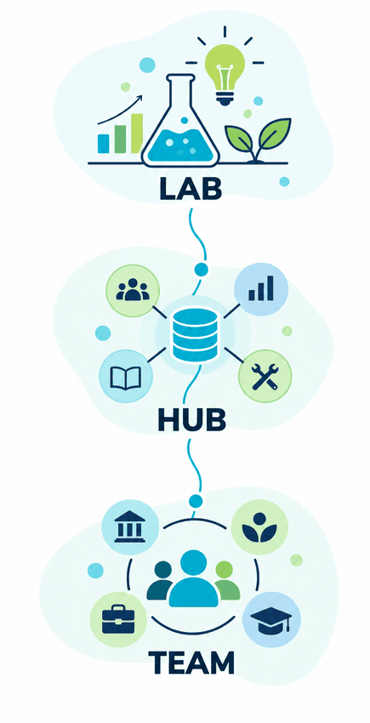
European social fund agency
Who are we?
Testing social innovations and measuring what works.
Bringing together expertise, data, knowledge and practical tools.
Connecting public authorities, NGOs, business and academia to create change together.

Slide 3
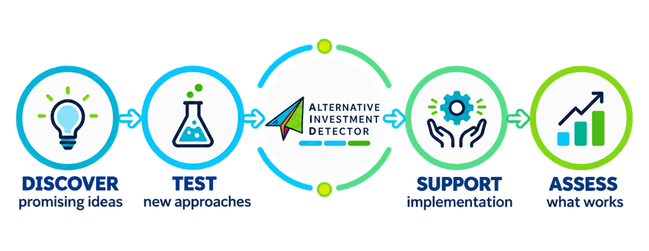
What is AID?
AID is not one solution. It is a way of finding better solutions.

Slide 4
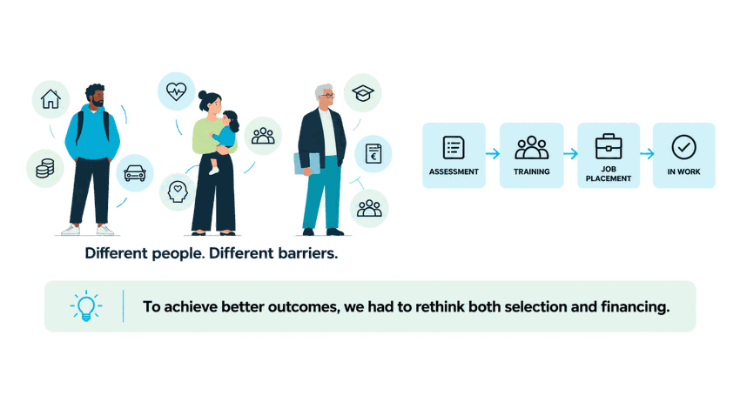
Social exclusion cannot always be solved with standard solutions
Long-term unemployment is often described as a problem of motivation.
Our experience led us to ask a different question.

Slide 5
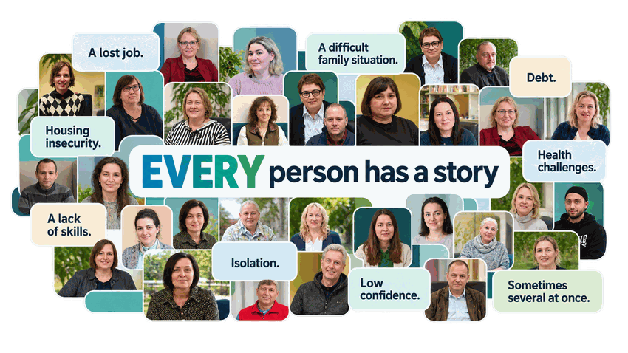

Slide 6
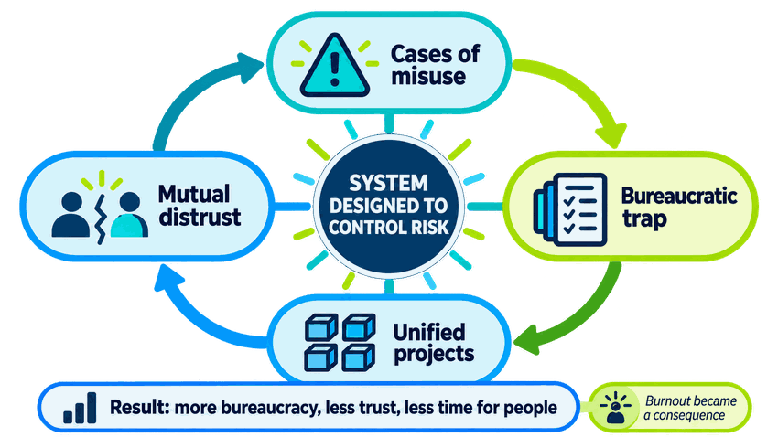
Why was AID needed?

Slide 7
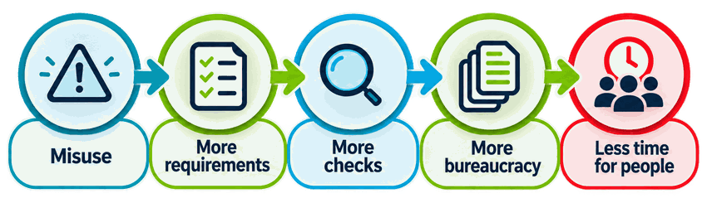
When more control creates more bureaucracy
The more we controlled the process, the less we focused on the outcome.

Slide 8
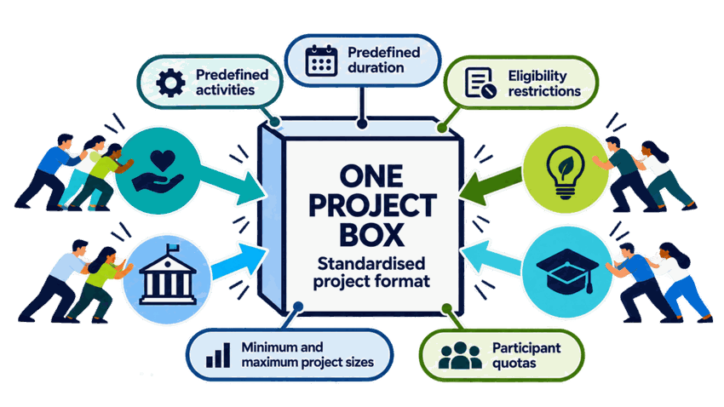
Standardisation made projects easier to control, but harder to adapt
The format was assessed more than the idea itself.

Slide 9
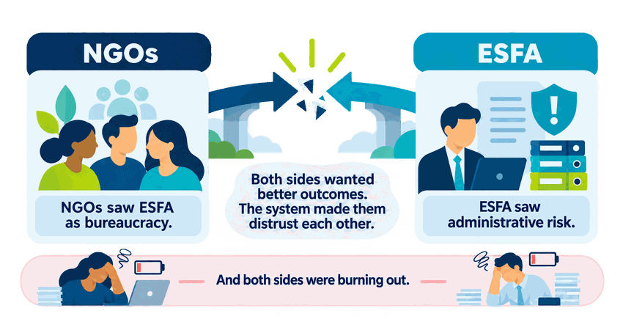
Mutual distrust

Slide 10
What did we change?

Slide 11
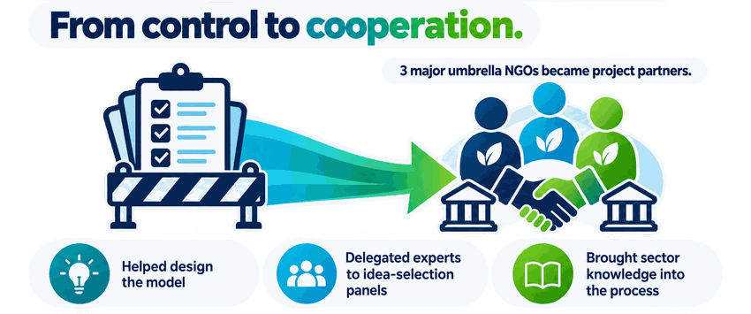
We changed the relationship first
We stopped designing for NGOs and started designing with them.

Slide 12
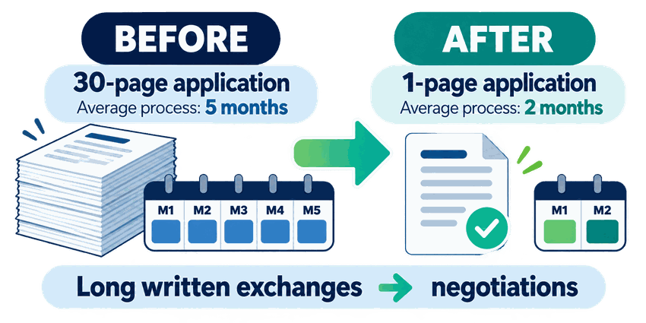
We simplified the process

Slide 13
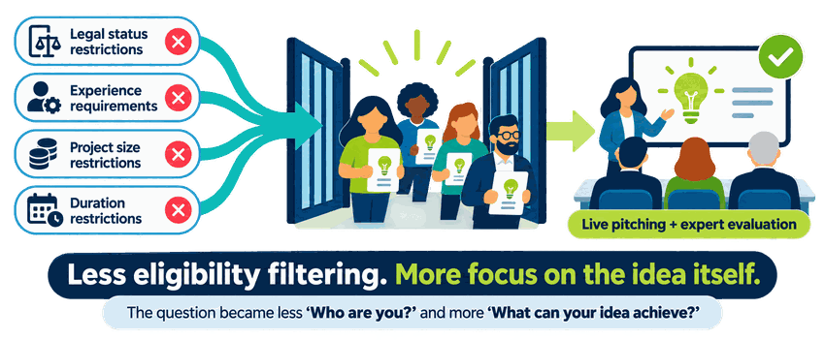
We opened the door to better ideas

Slide 14
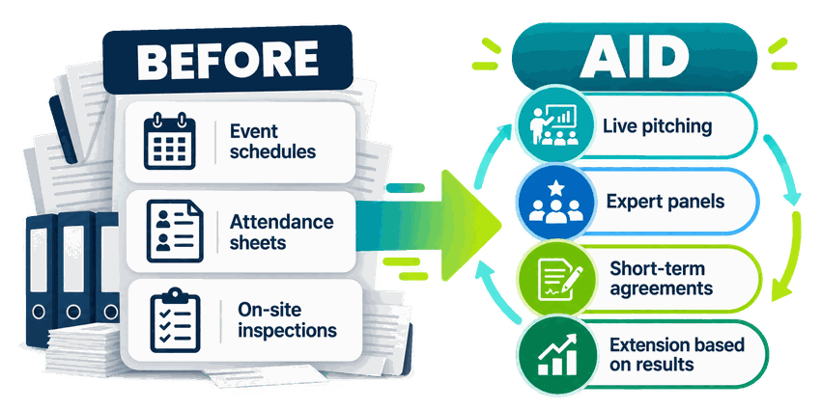
We changed how risk was managed

Slide 15
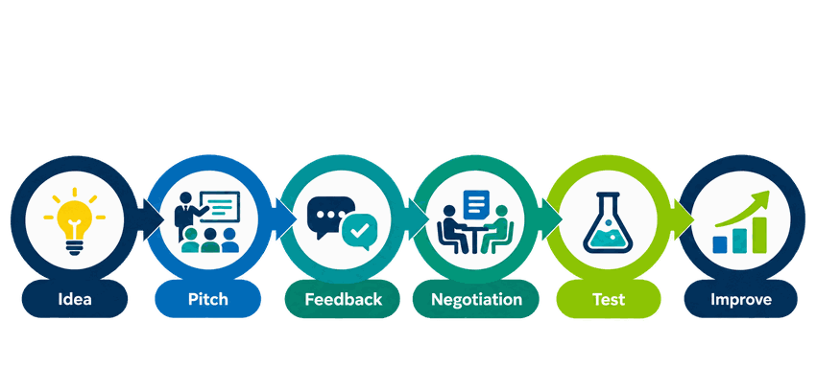
AID became a learning process
A good idea did not have to be perfect on day one.

Slide 16
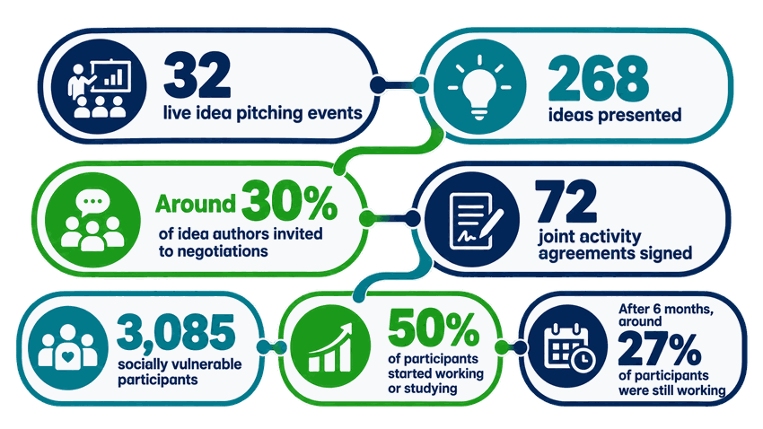
May the best idea win

Slide 17
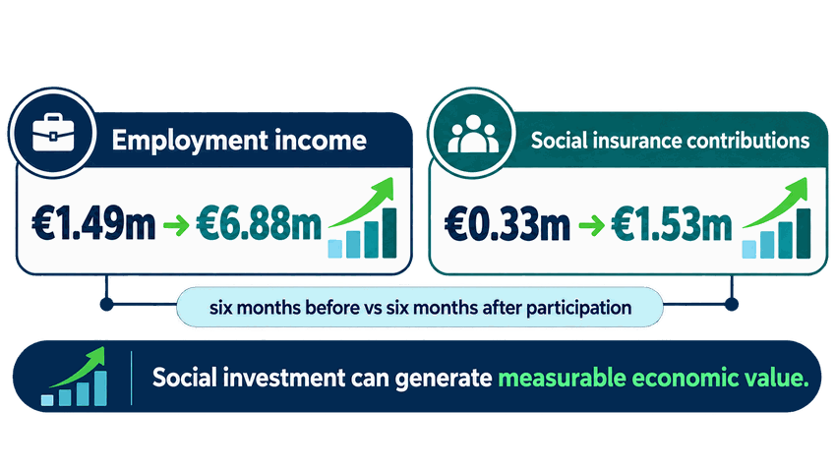
Why do we call it an investment?

Slide 18
If we give partners more flexibility, how do we maintain strong accountability?

Slide 19
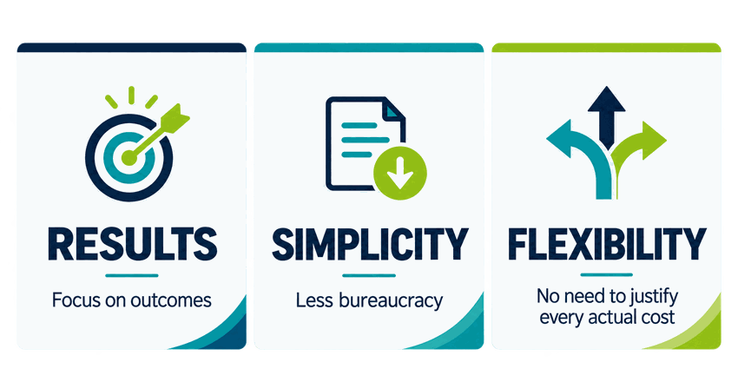
Financing Not Linked to Costs

Slide 20
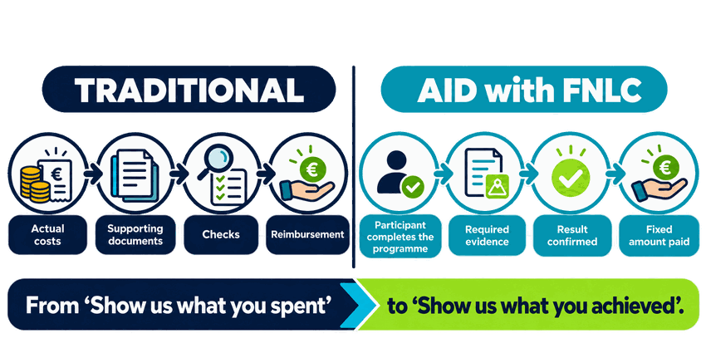
From checking costs to paying for completion

Slide 21
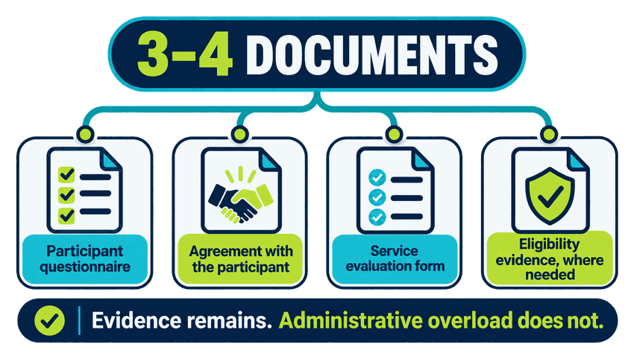
Less paperwork. More time for people.

Slide 22
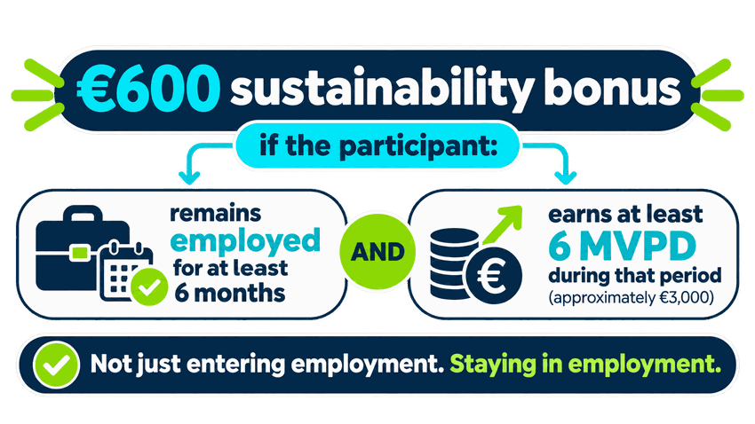
We also reward sustainable change

Slide 23
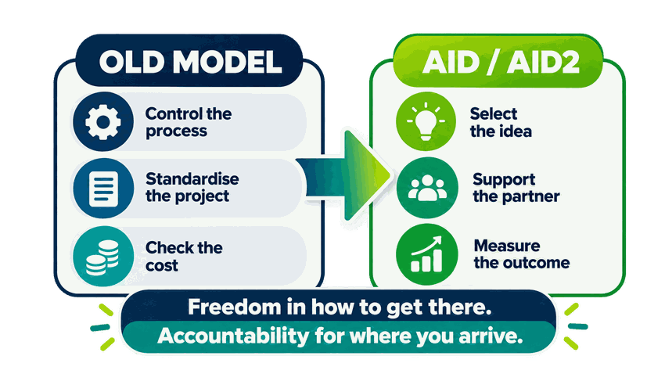
What changed?

Slide 24
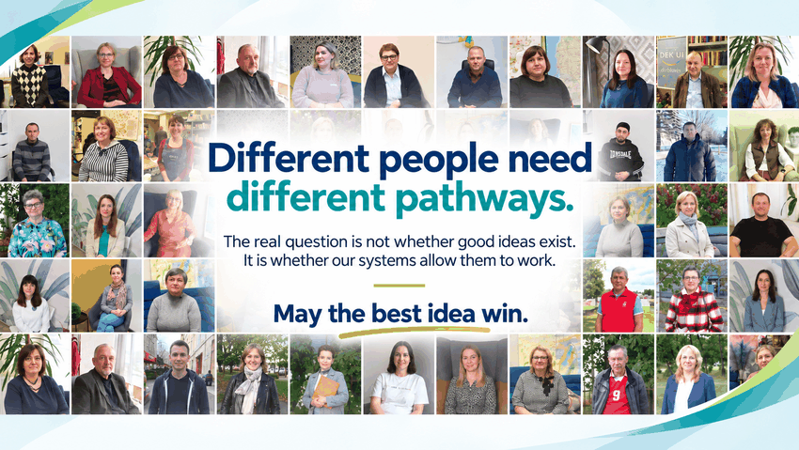

Slide 25
May the best idea win: projects that change lives.

